Slide 1

Development of website for a Training Organization
Module : Front End Web Development
Learner Name : Ida Bagus Ketut Yoghantara
Class : BDSE04-0322

Slide 2
1. Project Presentation Objective
Task 2
1. Create an Information Architecture & Storyboard for the website 2. Propose the Information flow for a Leads generation form & Its Administration (Login Not Required) a. User must be able to Add, Edit, Delete & List leads
Task 3
1. Develop the HTML Pages required for the website 2. Develop the Lead Generation Form & Administration System pages for Lead Generation form management.
Task 4
1. Propose & use jQuery Components such as menu, popup etc. as part of the website. 2. Design the required HTML for jQuery Components.
Task 6
1. Make changes to User Interface based on effectiveness metrics identified in Task 5. 2. Make the changes to HTML, CSS & JavaScript.

Slide 3
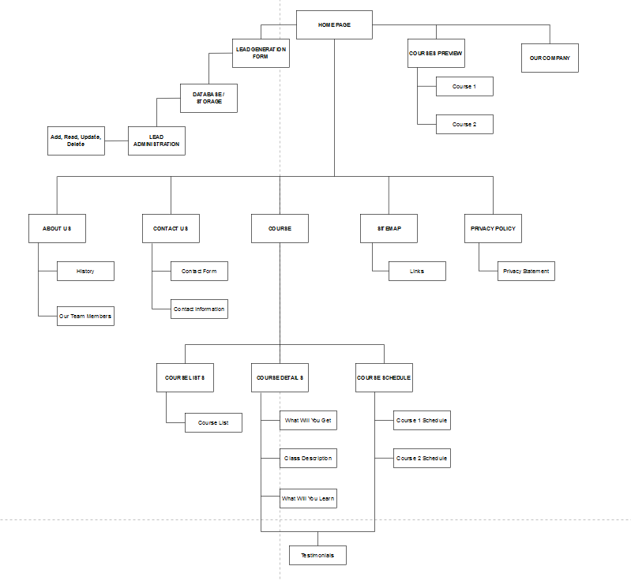
TASK 2 SOLUTION, Information Architecture

Slide 4
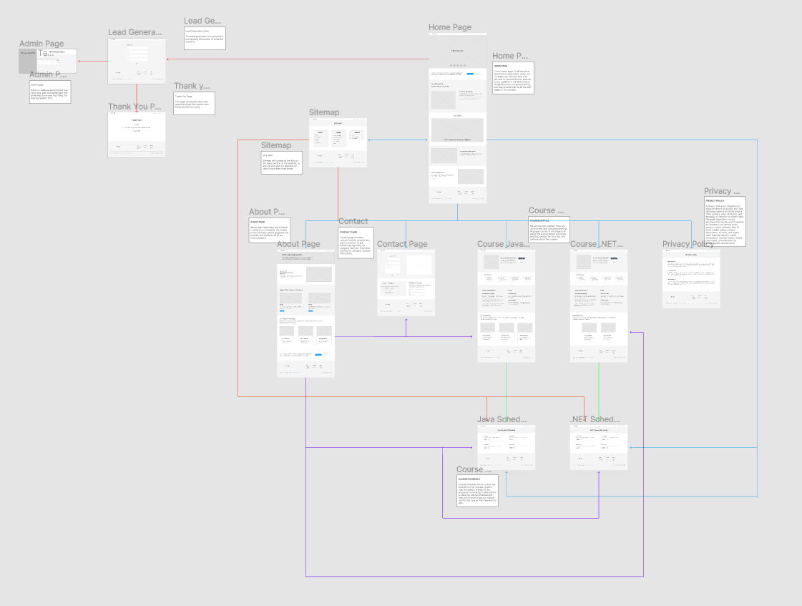
TASK 2 SOLUTION
1. Link to Figma : https://www.figma.com/file/PkhjM22ZXLLLg7ScEBGjXX/Gustut-Wireframe?node-id=0%3A1
Storyboard:

Slide 5

Information flow for Leads generation form & Its Administration
Add new lead data
Website User
Visit Website
Fill up lead form
Capture and store lead info
Website Storage / Database
Edit existing lead data
ABC Administrator
Delete lead data
Search lead data

Slide 6
TASK 3 SOLUTION, HTML CATALOG
Pages | Information
index.html | Home page
admin.html | Administration page, able to edit, delete, add lead generation data
about.html | Company history and team members profile
contact.html | Company contact information and contact form to send message to company
privacy-policy.html | Privacy statement
sitemap.html | Links to all the pages
course-list.html | Listing all the course
front-end.html | Front End course details
back-end.html | Back End course details
front-end-schedule.html | Front end course schedule

Slide 7
Pages | Information
back-end-schedule.html | Back end course schedule
registration.html | Lead registration form page
thank-you.html | Thank you message page after user successfully submit the lead generation form

Slide 8
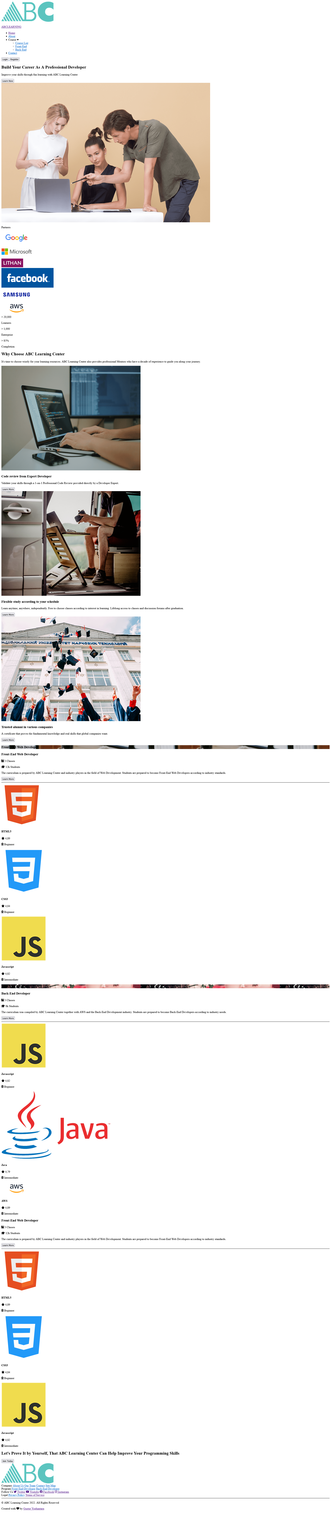
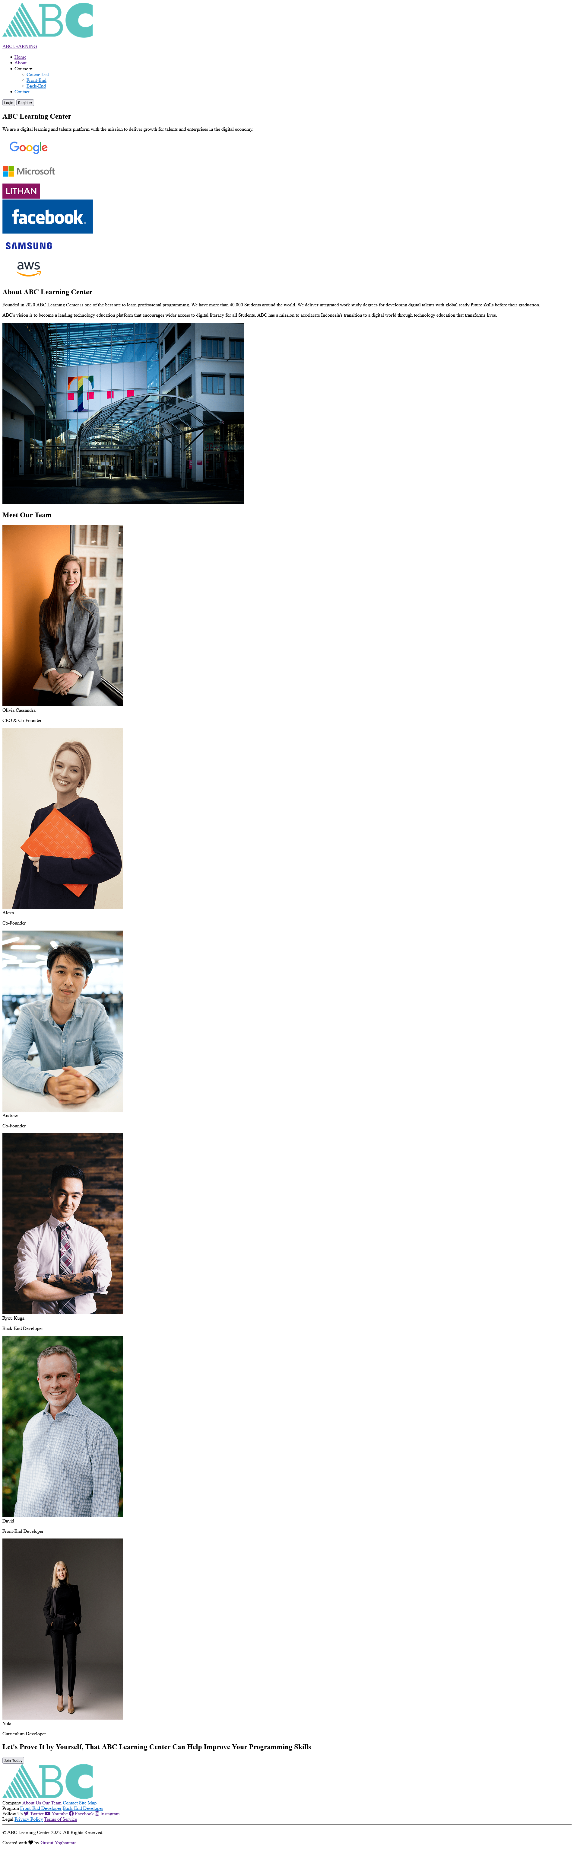
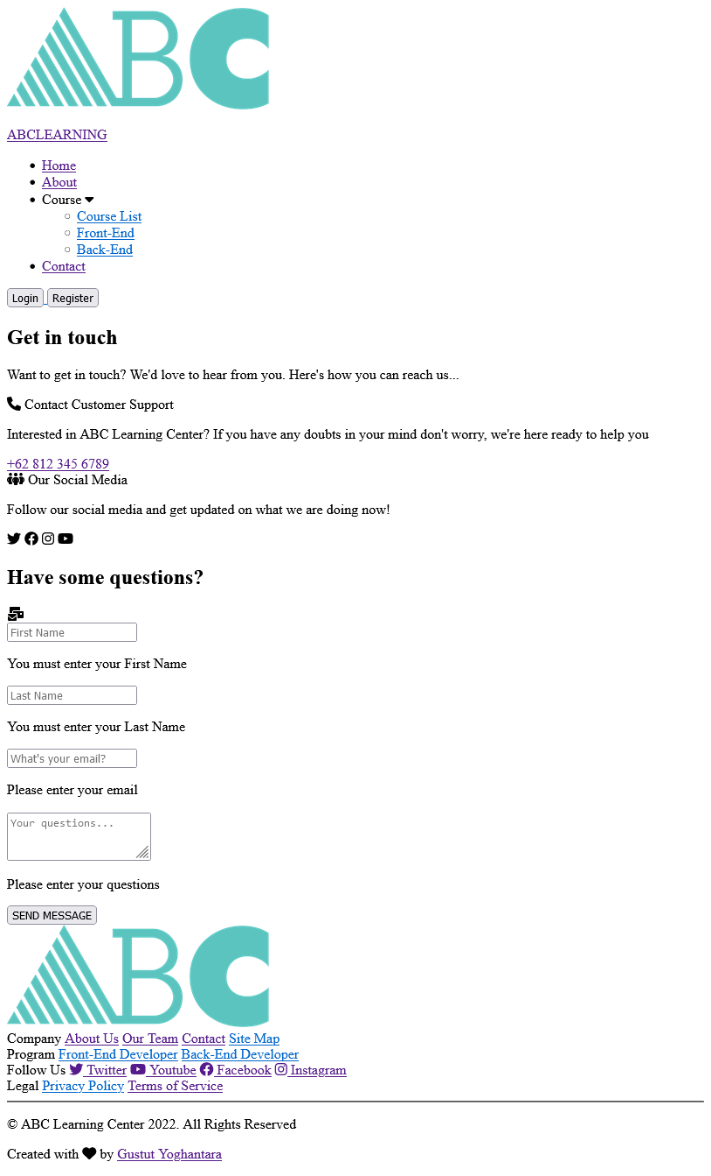
TASK 3 SOLUTION, HTML PAGES Without CSS
HOME PAGE
ABOUT PAGE
CONTACT PAGE

Slide 9
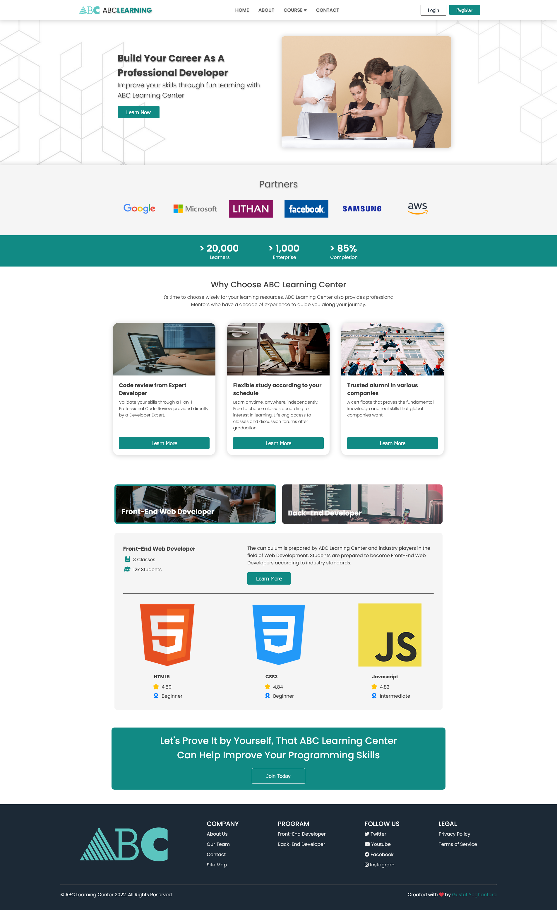


TASK 3 SOLUTION, HTML PAGES
HOME PAGE
ABOUT PAGE
CONTACT PAGE

Slide 10
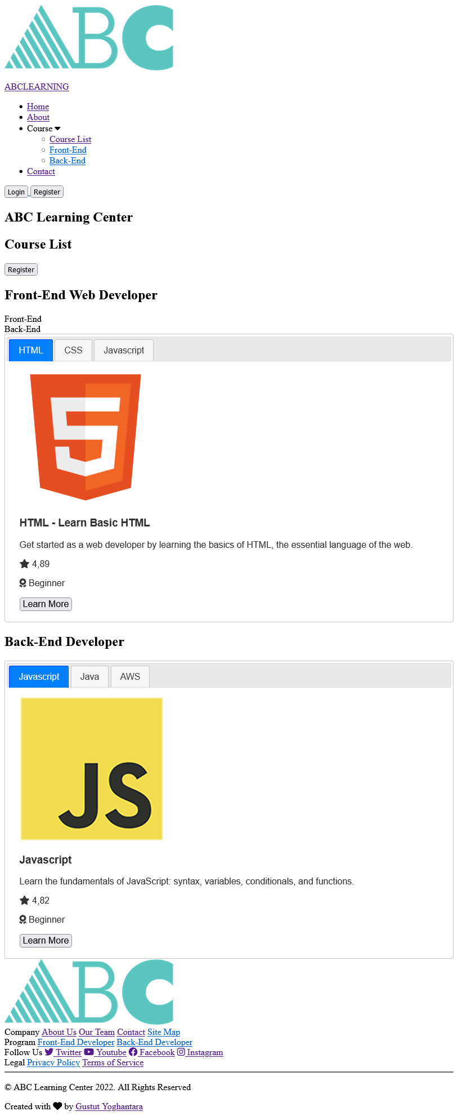
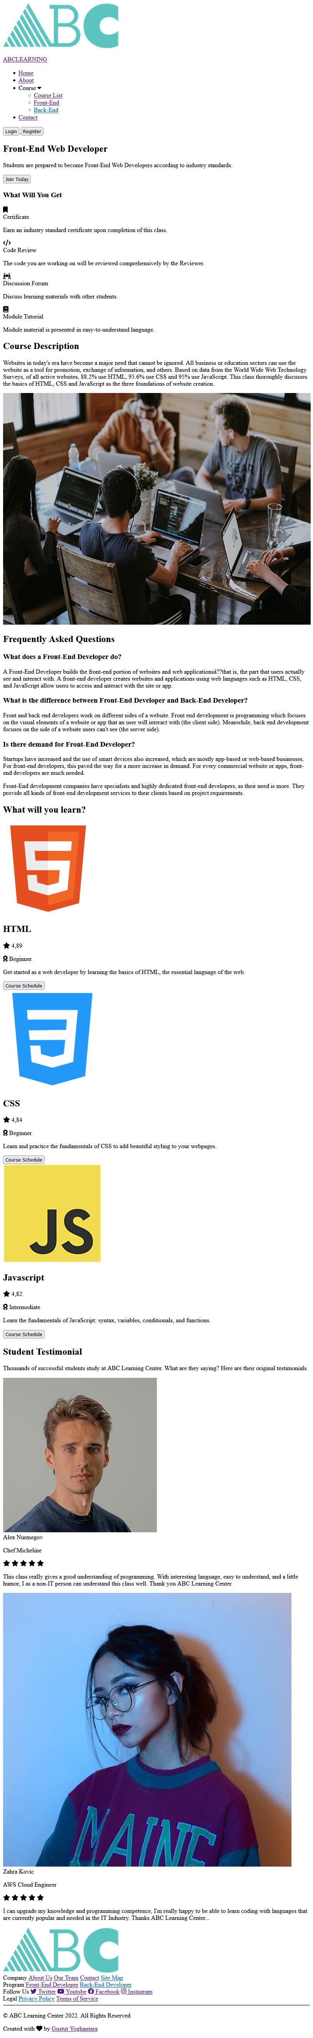
TASK 3 SOLUTION, HTML PAGES Without CSS
COURSE LIST PAGE
COURSE DETAILS PAGE

Slide 11
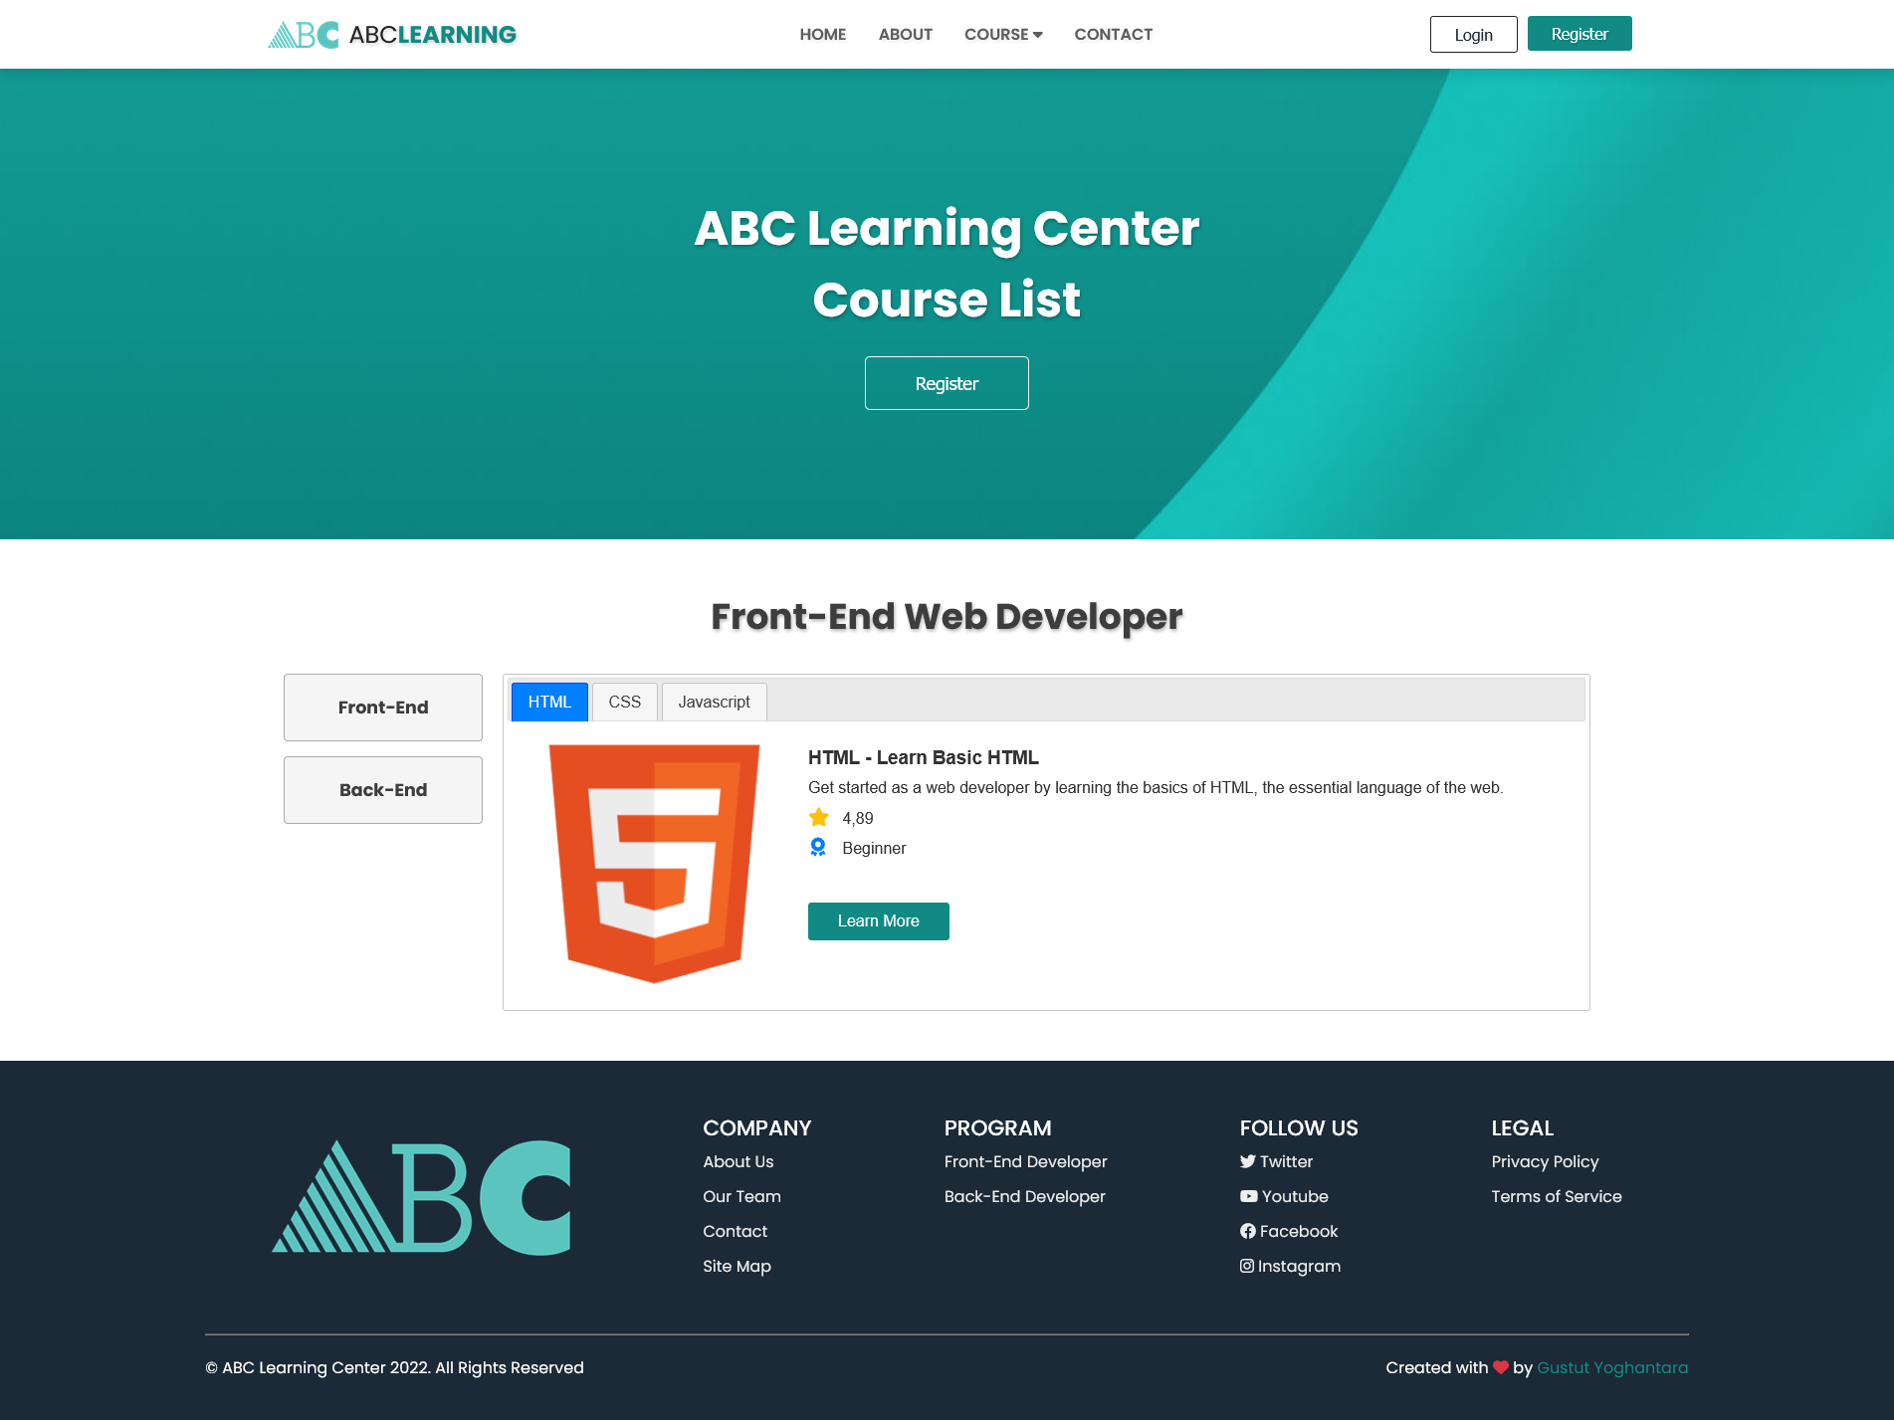
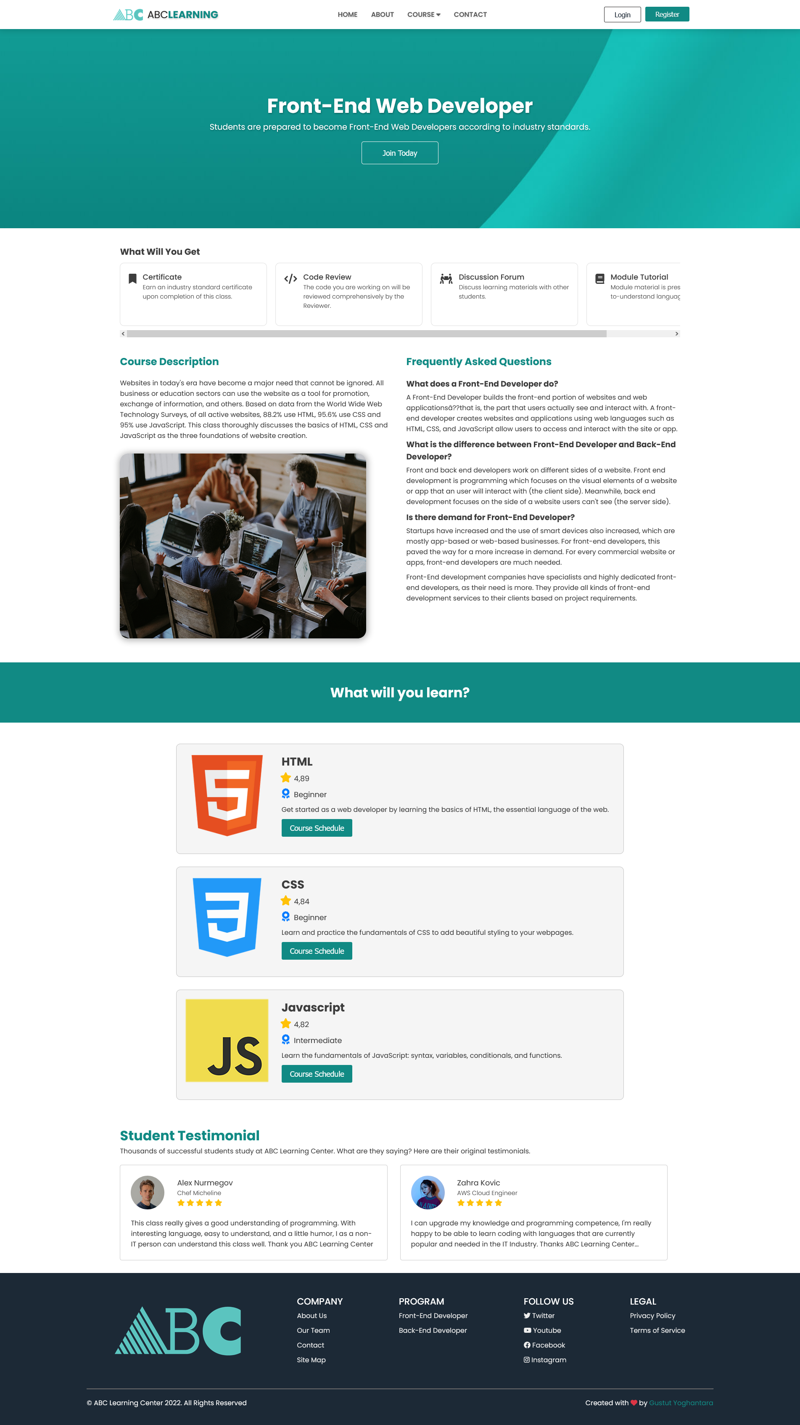
TASK 3 SOLUTION, HTML PAGES
COURSE LIST PAGE
COURSE DETAILS PAGE

Slide 12
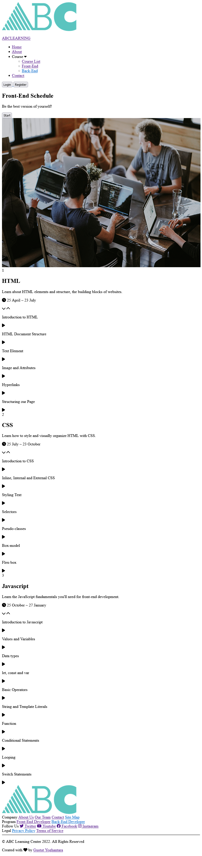
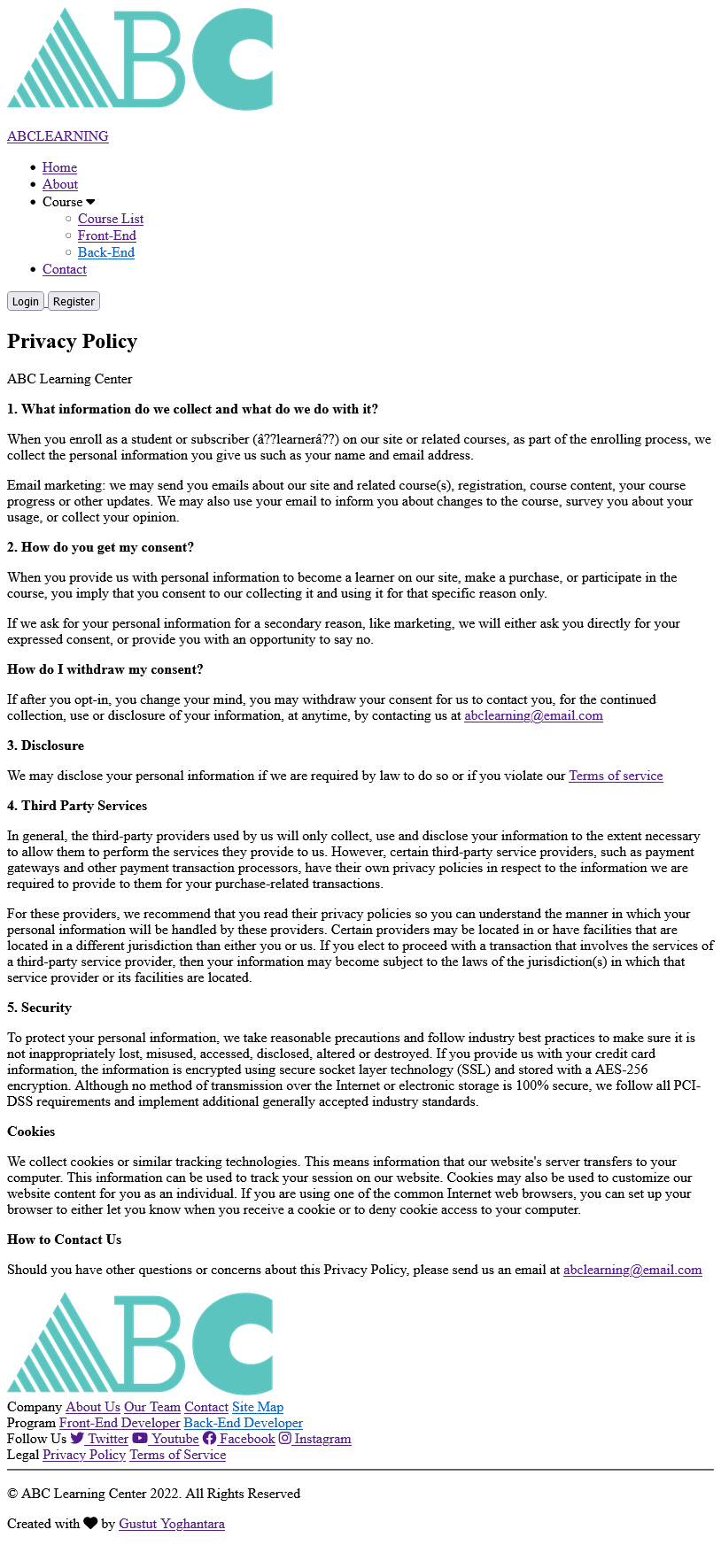
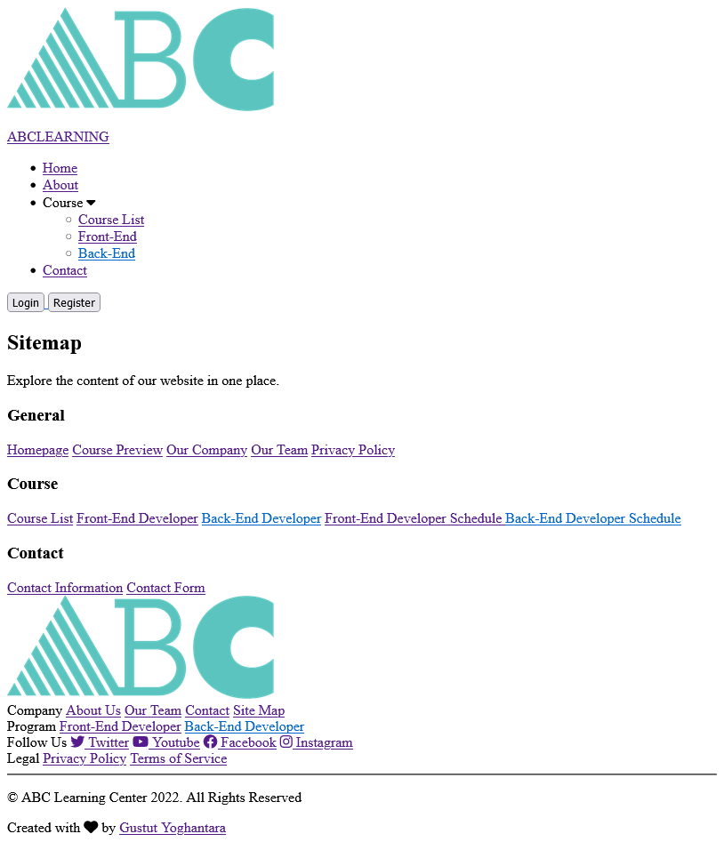
TASK 3 SOLUTION, HTML PAGES Without CSS
COURSE SCHEDULE PAGE
PRIVACY POLICY PAGE
SITEMAP PAGE

Slide 13
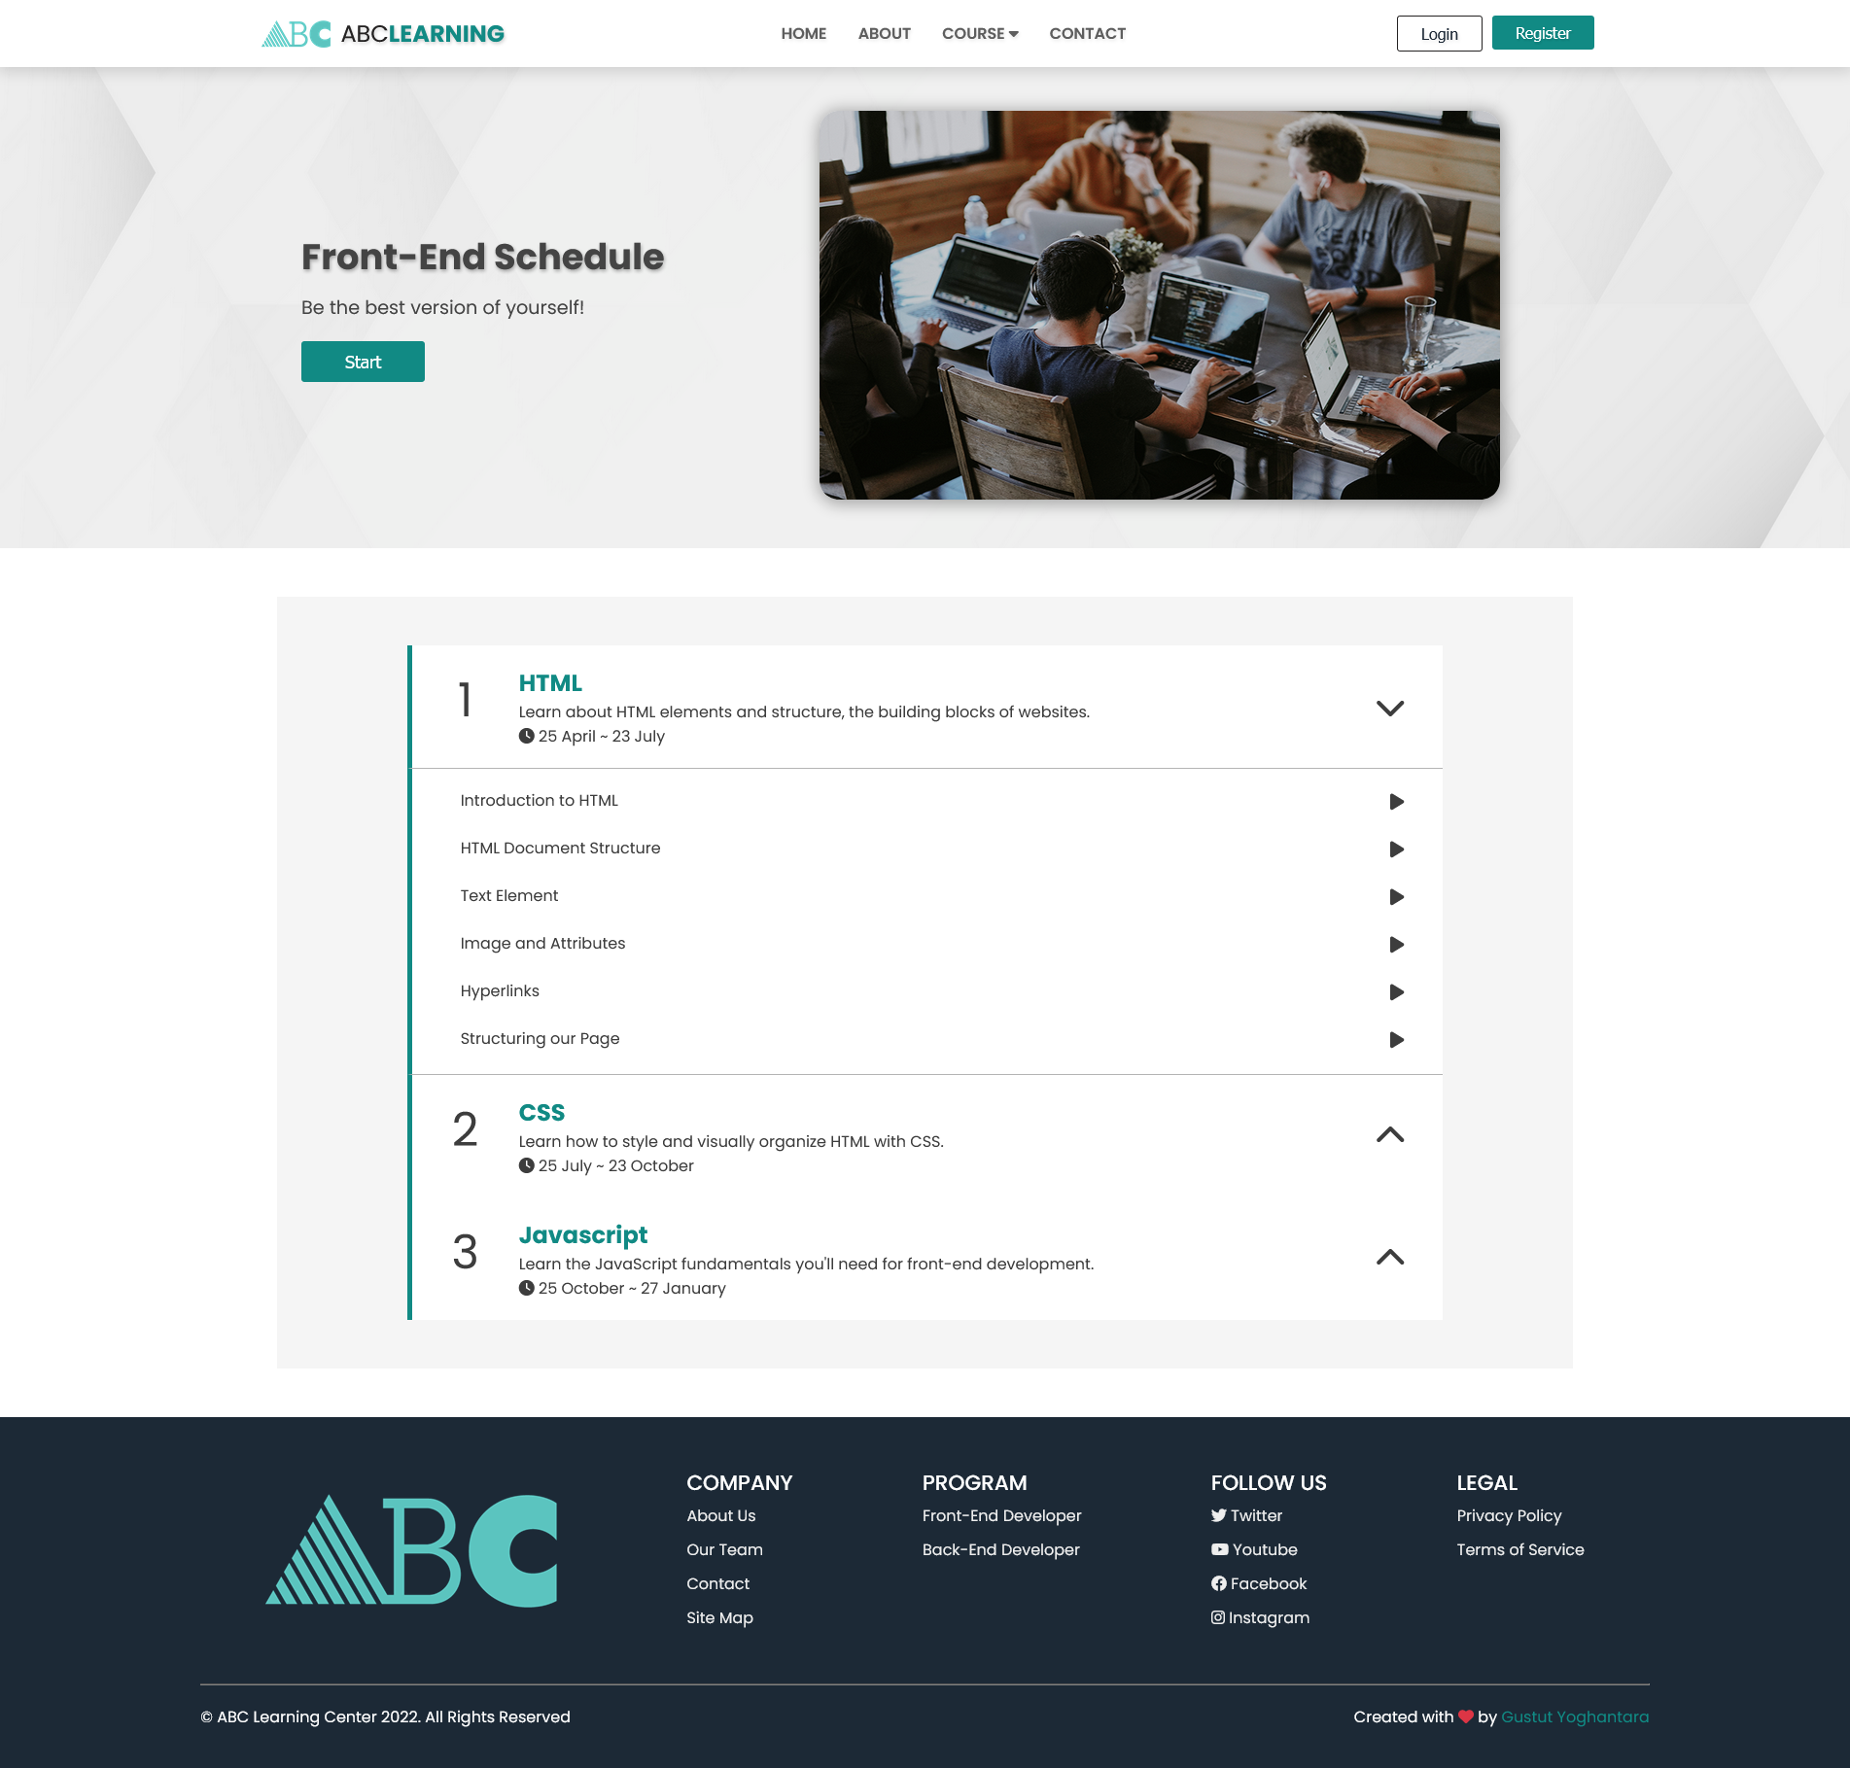

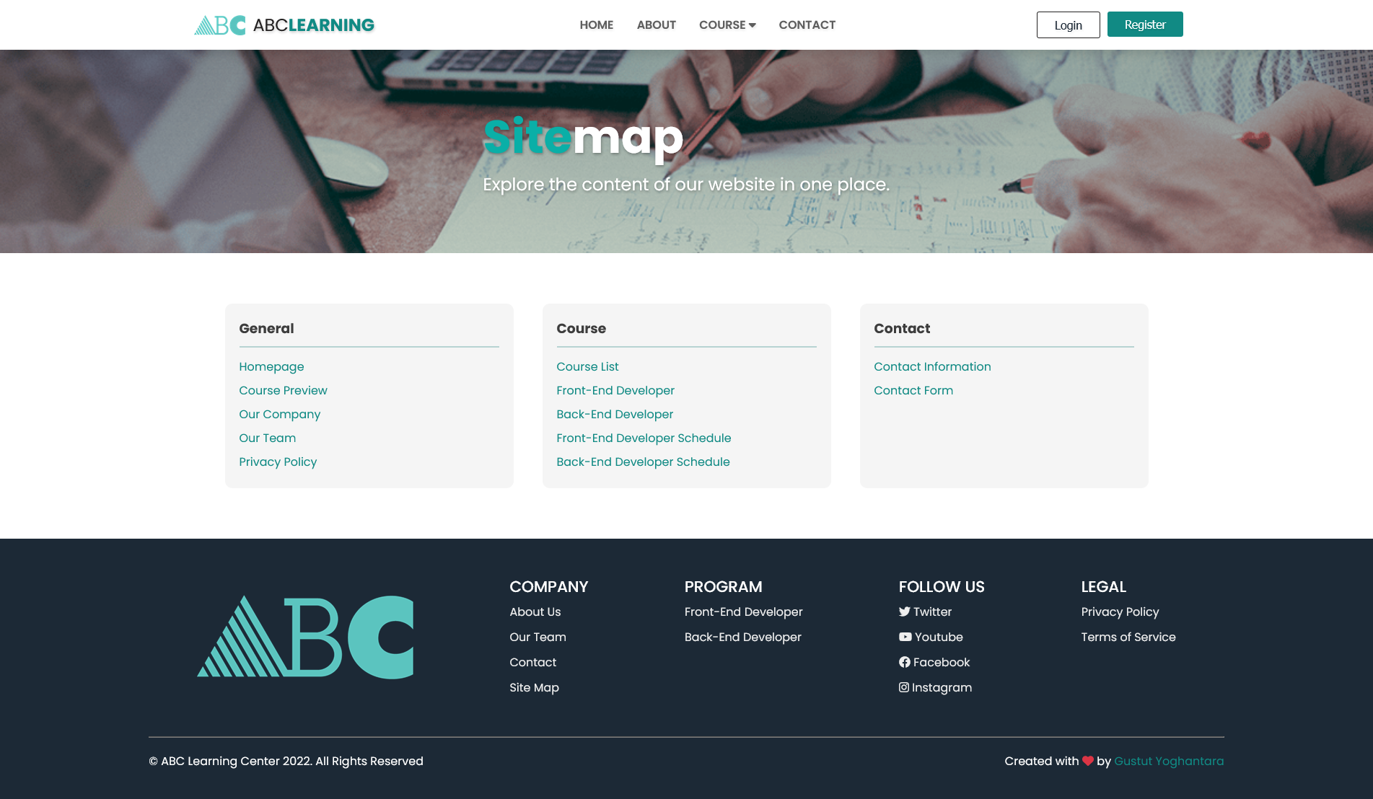
TASK 3 SOLUTION, HTML PAGES
COURSE SCHEDULE PAGE
PRIVACY POLICY PAGE
SITEMAP PAGE

Slide 14
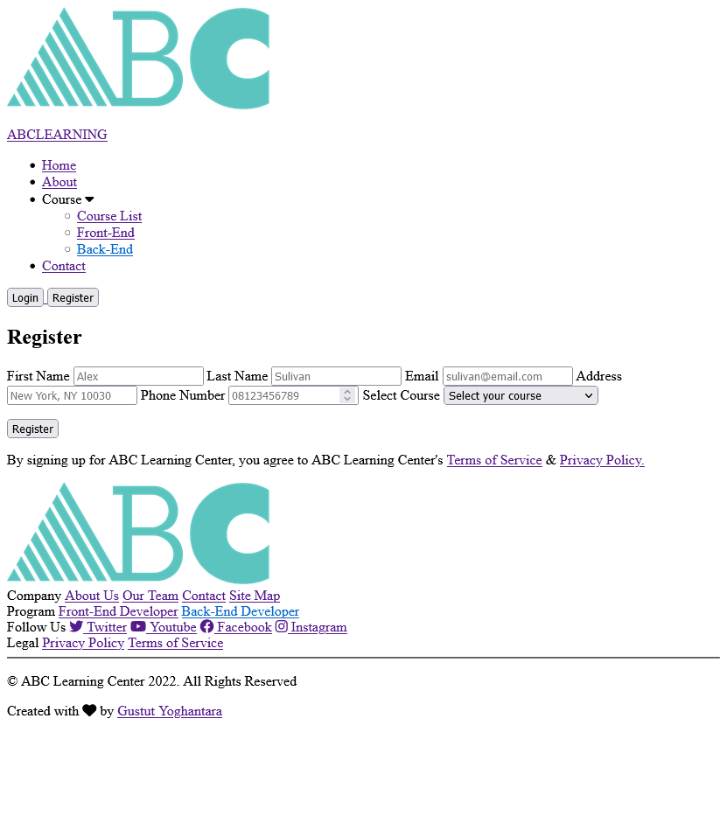
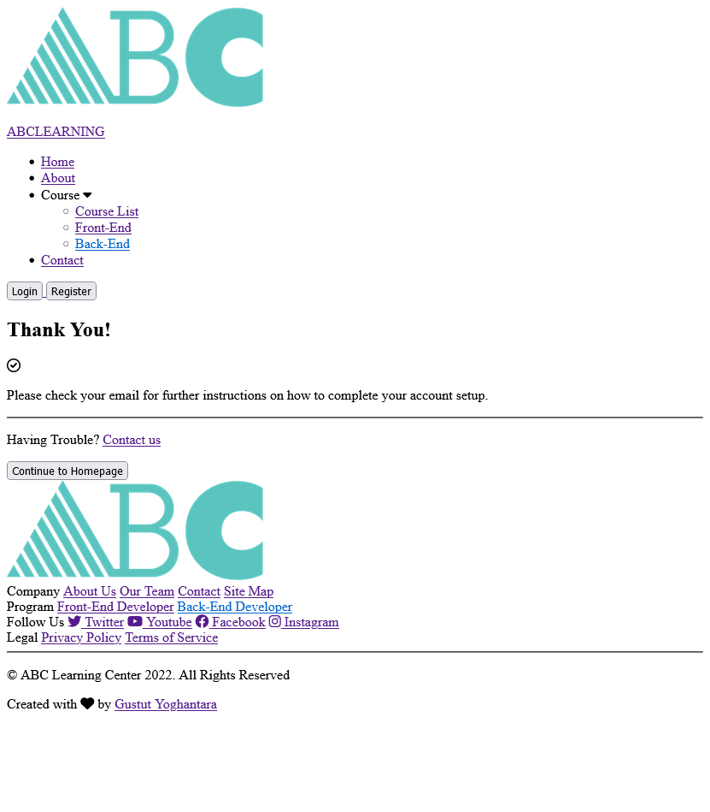
TASK 3 SOLUTION, HTML PAGES Without CSS
LEAD REGISTRATION PAGE
THANK YOU PAGE

Slide 15
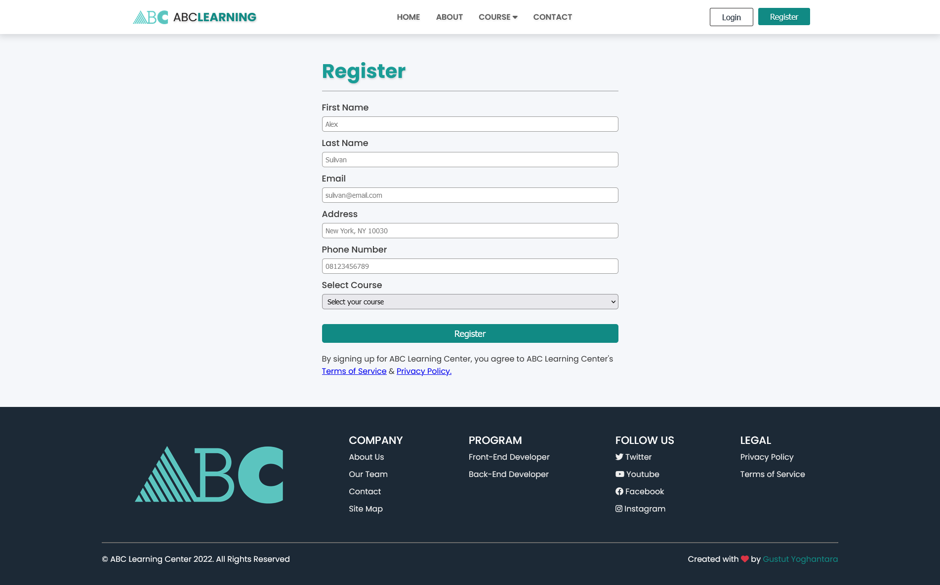
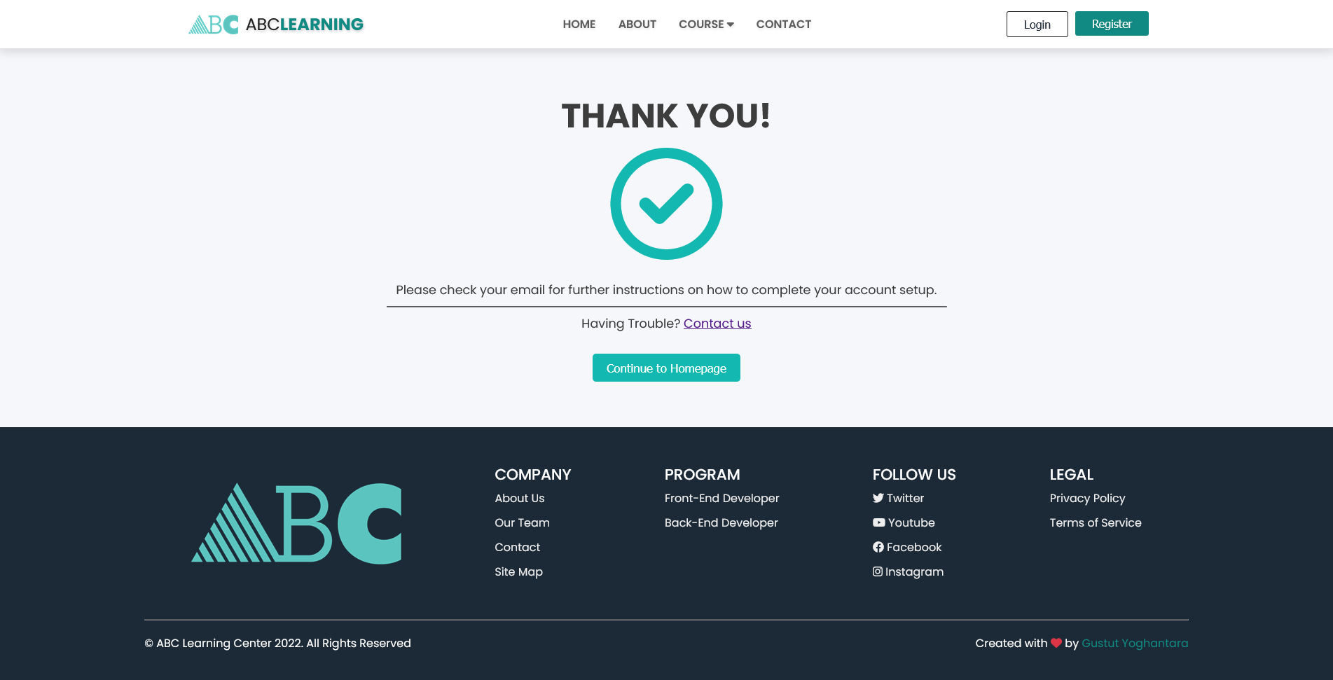
TASK 3 SOLUTION, HTML PAGES
LEAD REGISTRATION PAGE
THANK YOU PAGE

Slide 16
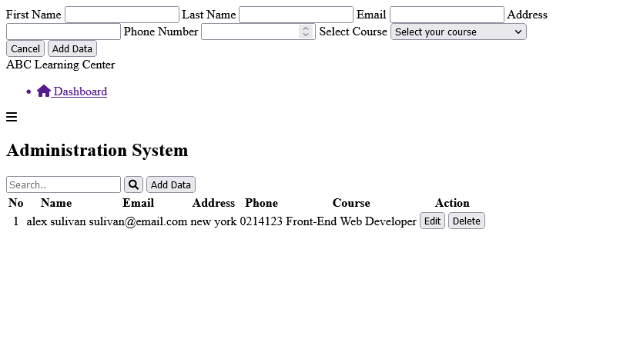
TASK 3 SOLUTION, HTML PAGES
ADMINISTRATION SYSTEM PAGE

Slide 17
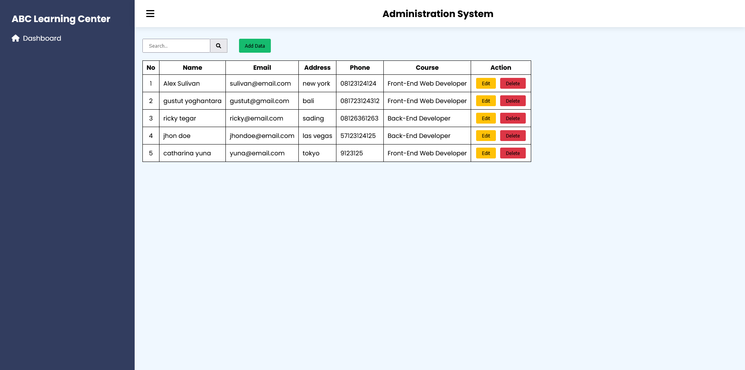
TASK 3 SOLUTION, HTML PAGES
ADMINISTRATION SYSTEM PAGE

Slide 18
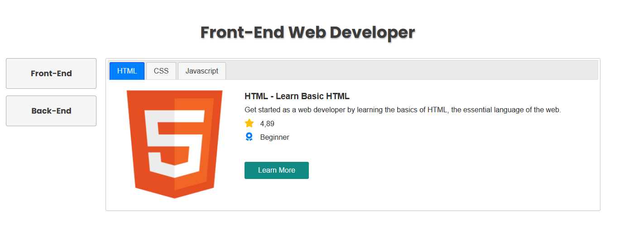
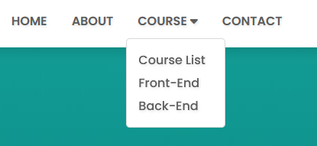
TASK 4 SOLUTION, jQuery Components
Tab & Menu

Slide 19
TASK 6 SOLUTION
From a UX perspective, it’s better to have no optional fields. Assuming that if a piece of information is not required there’s no point in wasting a user’s time. You can always ask further information down the line. But if there are still optional fields in your registration form, make sure to clearly highlight them with label (optional).
For more better user experience, the form need a placeholder on each input fields to make the user easier and faster to fill the form.

Slide 20
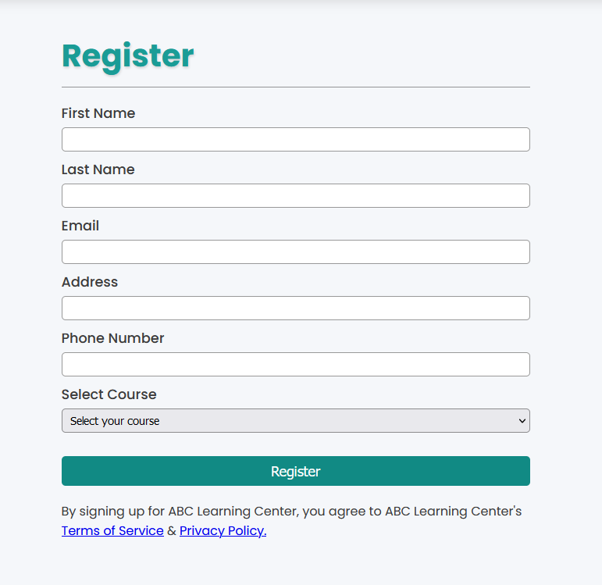
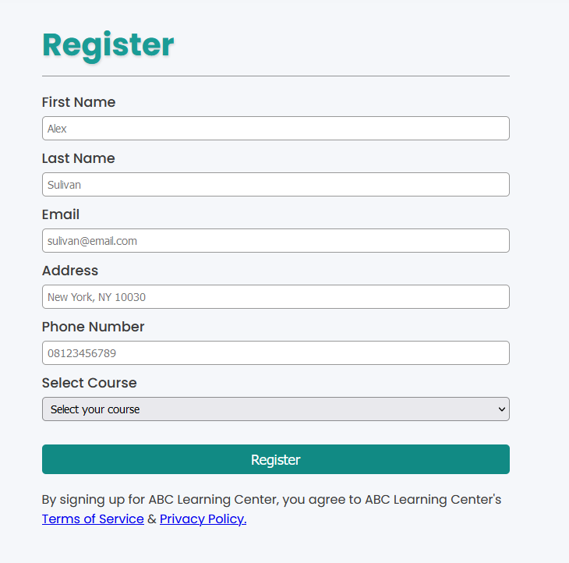
Before: After:

Slide 21
2. CSS Classes
NO | CSS Selector | Style to be created
1 | * | margin: 0; box-sizing: border-box;
2 | body | font-family: "Poppins", sans-serif; overflow-x: hidden; color: #3d3d3d;
3 | nav | background-color: white; position: relative; position: fixed; z-index: 9999; top: 0; left: 0; right: 0; box-shadow: 0px 1px 15px 3px rgba(0, 0, 0, 0.15);
4 | .nav-container | display: flex; justify-content: space-evenly; align-items: center; padding-top: 10px; padding-bottom: 10px;

Slide 22
NO | CSS Selector | Style to be created
5 | .anchor-logo | text-decoration: none;
6 | .nav-logo | display: flex; align-items: center; height: 40px; padding: 6px; border-radius: 6px; cursor: pointer;
7 | .nav-logo img | width: 100%; height: 100%;
8 | .nav-logo p | margin-left: 10px; font-size: 1.5rem; color: #242222; font-weight: 400; text-shadow: 1px 2px 3px rgba(0, 0, 0, 0.2);
9 | .nav-logo span | color: #118a84; font-weight: bold;
10 | .nav-links | display: flex; padding: 0; list-style: none; text-transform: uppercase;

Slide 23
NO | CSS Selector | Style to be created
11 | .nav-link | padding: 12px 16px; border-radius: 3px; transition: 0.1s;
12 | .nav-link a | text-decoration: none; color: #5e5e5e; font-weight: 600; font-size: 1rem; text-shadow: 1px 2px 3px rgba(0, 0, 0, 0.1);
13 | .nav-link:hover | background-color: rgb(245, 245, 245);
14 | .dropdown | position: relative;
15 | #dropdown-link | cursor: pointer;
16 | .dropdown .dropdown-menu | position: absolute; padding: 0; width: 140px; padding: 10px; align-items: center; font-size: 0.9rem; left: 1px; margin-top: 10px; border-radius: 5px; border: 1px solid rgba(0, 0, 0, 0.15); background-color: #fff; display: none;

Slide 24
NO | CSS Selector | Style to be created
17 | .dropdown .dropdown-menu.show | display: block;
18 | .dropdown-menu li | list-style: none;
19 | .dropdown-menu .dropdown-item | display: block; text-transform: none; font-weight: 500; margin: 5px 5px;
20 | .dropdown-menu .dropdown-item:hover | color: #118a84;
21 | .nav-button | display: flex;
22 | .btn-login | font-size: 1rem; padding: 8px 24px; background-color: #fff; border: 1px solid #242222; color: #1f2b38; border-radius: 3px; margin-right: 10px; transition: 0.2s; cursor: pointer; text-shadow: 1px 2px 3px rgba(0, 0, 0, 0.1);
23 | .btn-login:hover | color: #fff; background-color: #118a84; border: 1px solid #118a84;

Slide 25
NO | CSS Selector | Style to be created
24 | .btn-register | font-size: 1rem; padding: 8px 24px; background-color: #118a84; border: none; color: white; border-radius: 3px; cursor: pointer; text-shadow: 1px 2px 1px rgba(0, 0, 0, 0.1); transition: 0.2s;
25 | .btn-register:hover | opacity: 0.7;
26 | .hamburger-menu | display: none; height: 20px; flex-direction: column; justify-content: space-between; position: relative; cursor: pointer; align-items: flex-end;
27 | .hamburger-menu span | display: block; width: 28px; height: 3px; background-color: rgb(0, 0, 0); border-radius: 2px; transition: 0.5s;

Slide 26
NO | CSS Selector | Style to be created
28 | .hamburger-menu span:nth-child(2).active | width: 20px;
29 | .hamburger-menu span:nth-child(3).active | width: 12px;
30 | footer | position: absolute; right: 0; left: 0; background-color: rgb(28, 41, 54); color: #fff; display: flex; justify-content: center; padding: 0px 20px 20px 20px;
31 | .footer-container | width: 80%; transition: 0.3s;
32 | .footer-content | display: flex; justify-content: space-around;
33 | .footer-logo | display: flex; align-items: center; padding: 50px 0;
33 | .content | display: flex; flex-direction: column; padding: 50px 0;

Slide 27
NO | CSS Selector | Style to be created
34 | .content .header | font-size: 1.35rem; text-transform: uppercase; font-weight: 500;
35 | .content a | text-decoration: none; color: #eeeeee; padding: 5px 0;
36 | .content a:hover | color: #118a84;
37 | .footer-copyright | display: flex; justify-content: space-between; padding: 20px 0;
38 | .created-by i | color: #dc3545;
39 | .created-by a | color: #118a84; text-decoration: none;
40 | .created-by a:hover | text-decoration: underline;
41 | #join-today | background-color: #118a84; margin-top: 50px; min-height: 30vh; color: #fff; display: flex; justify-content: center; align-items: center; width: 60%; margin: 50px auto; border-radius: 10px;

Slide 28
NO | CSS Selector | Style to be created
42 | .container-join | width: 80%;
43 | #join-today .container-join | padding: 20px; text-align: center;
44 | #join-today .container-join h2 | font-size: 2rem; font-weight: 500;
45 | .btn-join-today | cursor: pointer; margin-top: 20px; padding: 15px 50px; color: #fff; background-color: transparent; border: 1px solid #f5f5f5; border-radius: 5px; font-size: 1.1rem; transition: 0.3s;
46 | .btn-join-today:hover | background-color: #f5f5f5; color: #118a84;

Slide 29
3. CSS Properties
NO | CSS | Style to be created
1 | Margin | Create space around elements, outside of any defined borders
2 | Padding | Generate space around an elements content, inside of any defined borders
3 | Box-sizing: border-box; | The box-sizing property allows us to include the padding and border in an element's total width and height.
4 | Font-family | Specifies a prioritized list of one or more font family names and/or generic family names for the selected element.
5 | Overflow-x | property sets what shows when content overflows a block-level element's left and right edges. This may be nothing, a scroll bar, or the overflow content.
6 | Background-color | Give background color to elements
7 | Color | Give color to an element
8 | Position | property sets how an element is positioned in a document.
9 | Z-index | sets the z-order of a positioned element and its descendants or flex items. Overlapping elements with a larger z-index cover those with a smaller one.
10 | Display: flex; | The Flexible Box Layout Module, makes it easier to design flexible responsive layout structure without using float or positioning.

Slide 30
NO | CSS | Style to be created
11 | Display: block; | Displays an element as a block element. It starts on a new line, and takes up the whole width.
12 | Display: none; | Hide the elements without deleting them
13 | Box-shadow | Attaches one or more shadows to an element
14 | Justify-content | Aligns the flexible container items when the items do not use all available space on the main-axis (x)
15 | Align-items | Aligns items inside the flexible container (y-axis)
16 | Text-decoration: none; | Remove underline from anchor tag
17 | List-style: none; | Remove pseudo content before each list item
18 | Width | Sets the width of an element
19 | Height | Sets the height of an element
20 | Border | Add border to an element
21 | Border-radius | Defines the radius of the element’s corners
22 | Cursor: pointer; | Change the cursor to pointer when the element is hovered
23 | Font-size | Sets the size of a font
24 | Font-weight | Sets the thickness of a font
25 | Text-shadow | Adds shadow to text

Slide 31
NO | CSS | Style to be created
26 | Text-transform | Controls the capitalization of text
27 | Transition | Give animation speed when changing CSS properties
28 | Opacity | Specifies the transparency of an element
29 | Flex-direction | Specifies the direction of the flexible items
30 | Visibility | Specifies whether or not an element is visible, visibility hidden take up space on the page unlink display none
31 | Transform | Applies a 2d or 3d transformation to an element
32 | Flex-wrap | Specifies whether the flexible items should wrap or not.
33 | Media query | Used to make an element responsive
34 | ::after | Insert something after the content of each selected element(s)
35 | :hover | Used to select elements when you mouse over them
36 | Background-image | Add image to the background of an element
37 | Background-size: cover; | Sets the width and height of the background image
38 | Background-position: center; | Sets the starting position of a background image
39 | Scroll-margin-top | Defines the top margin of the scroll snap area that is used for snapping this box to the snapport
40 | Outline | Line that is drawn around elements, outside the borders to make the element stand out

Slide 32
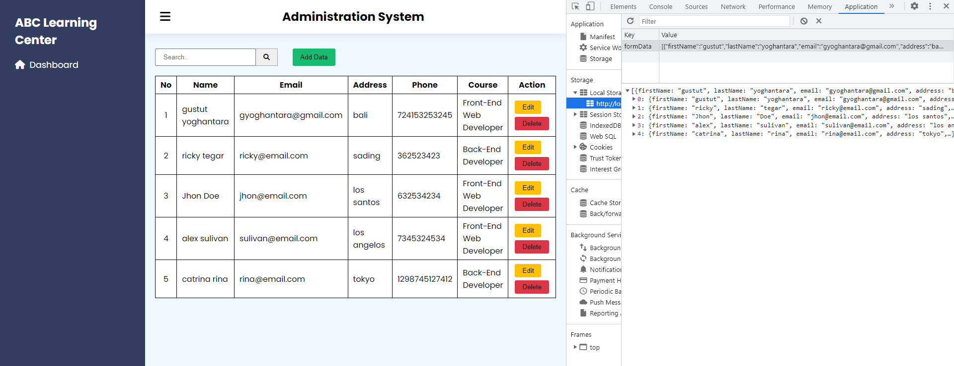
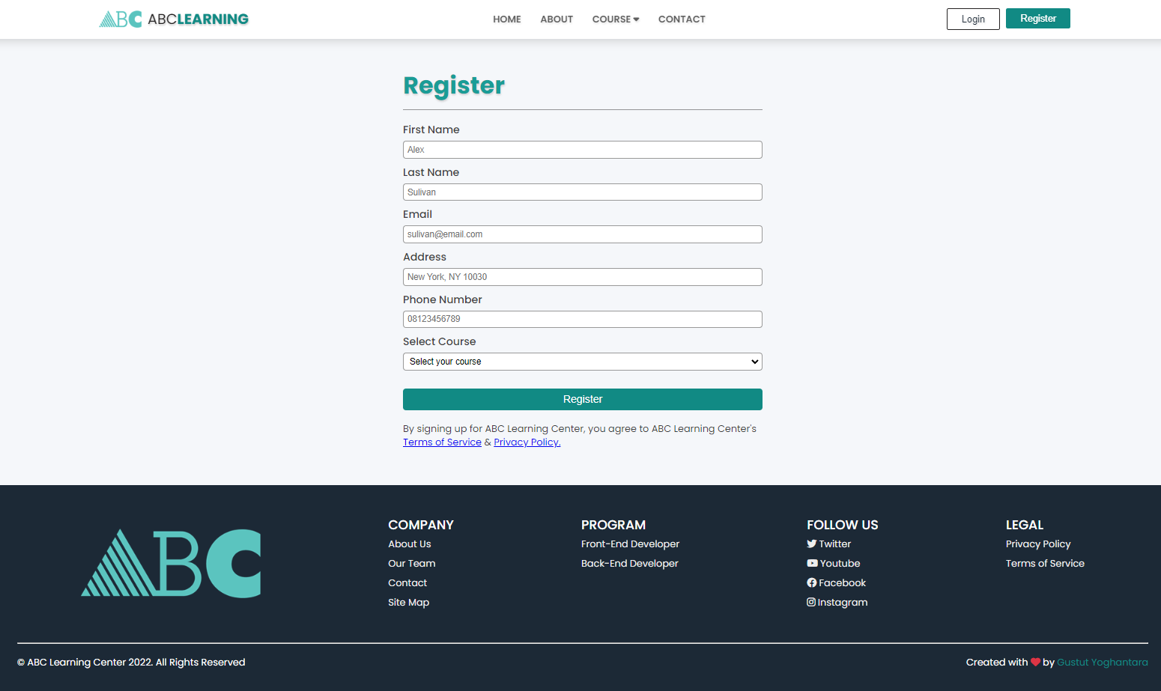
4. Project Results (1/2)

Slide 33
4. Project Results (2/2)
Link for the Project Walkthrough
ABC Learning Center website index page localhost:8080/Project/index.html
ABC Learning Center Lead Administration page localhost:8080/Project/admin.html

Slide 34
5. Development Tools
1. Visual Studio Code
Visual Studio Code features a lightning fast source code editor, perfect for day-to-day use. With support for hundreds of languages, VS Code helps you be instantly productive with syntax highlighting, bracket-matching, auto-indentation, box-selection, snippets, and more.
2. Draw.io (diagrams.net)
Diagrams.net (formerly draw.io) is a free and open source cross-platform graph drawing software developed in HTML5 and JavaScript. Its interface can be used to create diagrams such as flowcharts, wireframes, UML diagrams, organizational charts, and network diagrams
3. Unsplash.com
Beautiful, free images and photos that you can download and use for any project. Better than any royalty free or stock photos.
4. Freepik.com
Find and download the best high-quality photos, designs and mockups · All the assets you need, in one place.

Slide 35
5. Figma.com
Figma is a vector graphics editor and prototyping tool which is primarily web-based, with additional offline features enabled by desktop applications for mac OS and Windows. The Figma mobile app for Android and iOS allow viewing and interacting with Figma.
6. Apache Tomcat 9.0
Apache Tomcat is a free and open-source implementation of the Jakarta Servlet, Jakarta Expression Language, and Web Socket technologies. Tomcat provides a "pure Java" HTTP web server environment in which Java code can run.
7. Font Awesome
Font Awesome is the Internet's icon library and toolkit, used by millions of designers, developers, and content creators.
8. Mozilla Firefox
Mozilla Firefox, or simply Firefox, is a free and open-source web browser developed by the Mozilla Foundation and its subsidiary, the Mozilla Corporation. It uses the Gecko rendering engine to display web pages, which implements current and anticipated web standards.

Slide 36
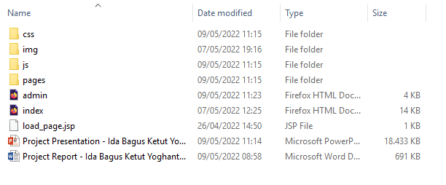
6. Project Deliverables
Project Deliverables a. HMTL pages b. CSS files c. Javascript files d. Project report e. Project presentation f. Source Code
List of Evidences

Slide 37
7. List of References
Linkedin.com/learning
W3school.com
Developer.mozilla.org
Jquery.com
Dicoding.com
Codepolitan.com
Zeroqode.com
Codeacademy.com
Udemy.com
Youtube.com
Getbootstrap.com
Geeksforgeeks.org

Slide 38
8. Milestone Feedback & Action taken
Project Milestone ID | Milestone Feedback received from Tutor / Learning Facilitator | Action Taken (Yes / No)
1 | Adding validation on administration system page | Yes
2 | Revise project result screenshot, list evidences & add project deliverables | Yes
3 | Adding milestone feedback in project presentation | Yes

